Slide 1

Coding CAT
By Hong ng

Slide 2
MY Aim
To create a code that can perform financial calculations in different scenarios.

Slide 3

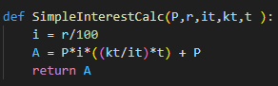
How it works
I used formulas for Simple and Compound Interest to create functions that I could then call on later in the code.
Example:

Slide 4
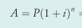

Formulas
Formula for Compound Interest with A being the final amount, P being the principal, n being the number of years, and i being the interest rate.
Formula for Simple Interest with I being the interest gained, P being the principal I being the interest rate, and n being the number of years

Slide 5
Important points

Slide 6

How I combated overflow errors
When I inserted days as a compounding time unit, I found that I was commonly receiving Overflow Errors which essentially meant that the number was too big for python to handle. After a bit of research, I found that there was no way to circumvent this, so I decided to deal with it ‘elegantly’. I did this by running my Interest Calculations using the try function which made the code print out an error message to alert the user that the error happened before defaulting the final amount to 0.

Slide 7
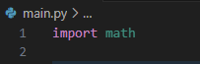
Libraries that I used
I intended to use math.ceil() to try combat the overflow error by rounding it each time to try stop the amount of decimals from causing the Overflow Error. However, I found that using round() was better as I could round to decimal places because math.ceil() only rounded down to the nearest whole number. In the end, the math module was not used but I couldn’t be bothered to take it out

Slide 8
End of presentation
By hong ng
I want to sleep

